Slide 1
Constructors in Java
In Java, a constructor is a block of codes similar to the method. It is called when an instance of the class is created. At the time of calling constructor, memory for the object is allocated in the memory.
Every time an object is created using the new keyword, at least one constructor is called.
It calls a default constructor if there is no constructor available in the class. In such case, Java compiler provides a default constructor by default.
There are two types of constructors in Java: no-arg constructor, and parameterized constructor.
There are two rules defined for the constructor.
Constructor name must be the same as its class name
Constructor must have no explicit return type
Java constructor cannot be abstract, static, final, and synchronized
Copy Constructor

Slide 2
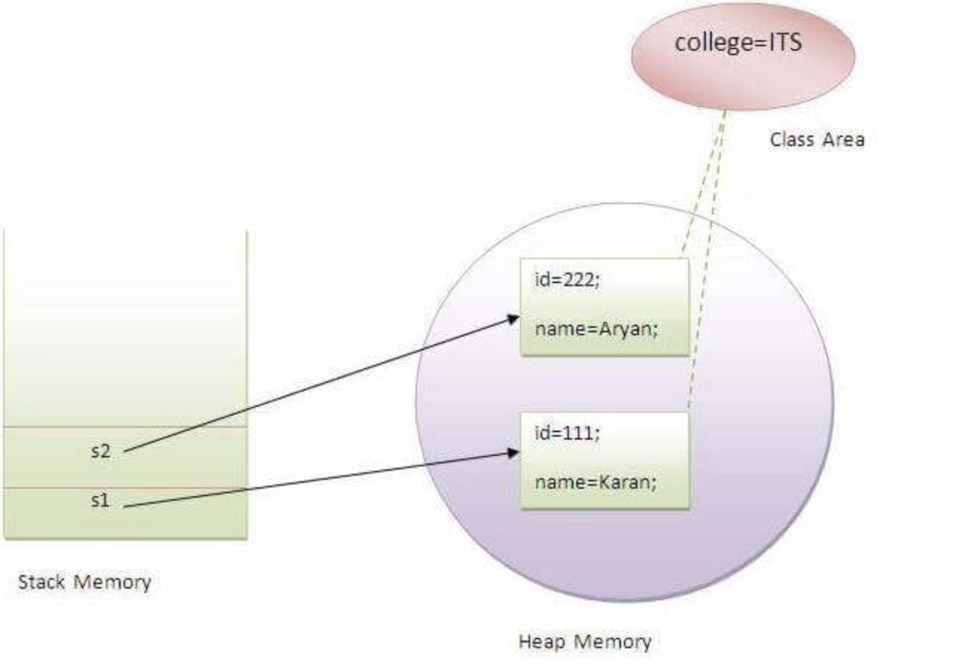
Java static keyword
The static keyword in Java is used for memory management mainly. We can apply static keyword with variables, methods, blocks and nested classes. The static keyword belongs to the class than an instance of the class.
The static can be:
Variable (also known as a class variable)
Method (also known as a class method)
Block
Nested class

Slide 3
StringBuilder vs StringBuffer(synchronized) class
StringBuilder is a class in the Java API that provides a mutable sequence of characters. It is used for
dynamic string manipulation, such as building strings from many smaller strings or appending new characters to
an existing string. Additionally, it is more efficient than using the "+" operator for string concatenation,
as this creates a unique string every time.
And added to this, Java String builder is a powerful tool for constructing strings. The builder can build strings of
any length, from a single character to many characters. The builder is also thread-safe to be used in
multi-threaded applications.
There are four constructors for the Java StringBuilder class.
StringBuilder(): This constructor creates an empty string builder object with no characters inside it with an initial capacity of 16.
StringBuilder(CharSequence seq): This type of constructor creates a string builder object with the specified sequence of characters as the initial value.
StringBuilder(int capacity): This specific constructor creates an empty string builder object with the specified capacity as the initial capacity.
StringBuilder(String str): This string constructor creates a string builder object with the specified string as the initial value.
The java StringBuilder class provides the following methods:
Append(): It appends the specified string to the end of the StringBuilder object.
Insert(): This function inserts the specified string at the fixed position in the StringBuilder object.
Delete(): It deletes the characters in the specified range from the StringBuilder object.
Delete chart(): This string deletes the character at the specified position from the StringBuilder object.
Reverse(): It reverses the characters in the StringBuilder object.
ToString(): This string method returns the string representation of the StringBuilder object.
SetLength(): It sets the character sequence's length, and the sequence is changed to a new length, either shorter or longer than the previous one.
Replace(): This specific string builder replaces a portion of this sequence with the specified string.

Slide 4
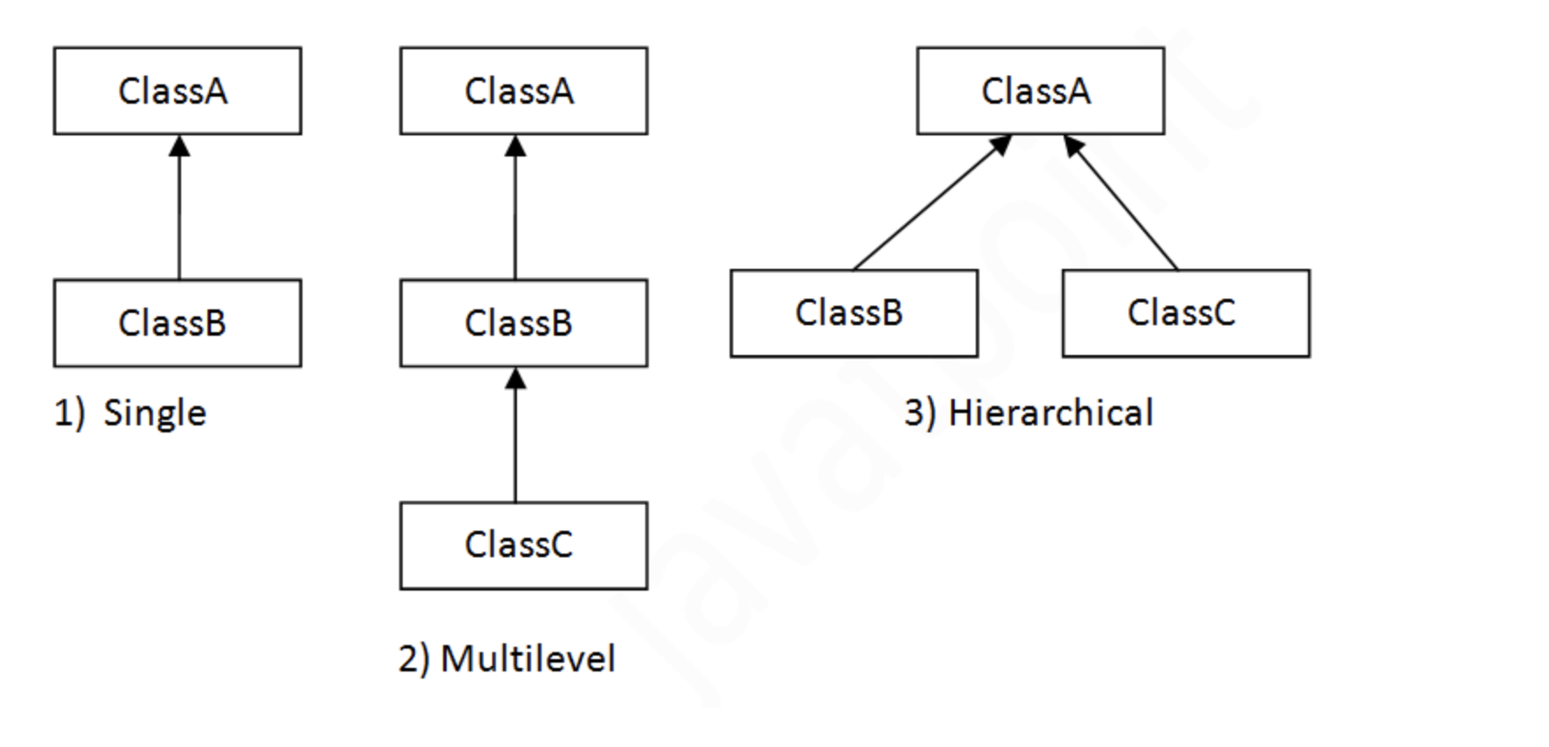
OOPS concepts()
Inheritance
Polymorphism
Abstraction
Encapsulation
Inheritance(extends)
Inheritance in Java is a mechanism in which one object acquires all the properties and behaviors of a parent object.
adv: Code Reusability.
disadv: Multiple inheritance not supported

Slide 5
Polymorphism
Method overloading
If a class has multiple methods having same name but different in parameters, it is known as Method Overloading.
There are two ways to overload the method in java
By changing number of arguments
By changing the data type
Method Overriding
If subclass (child class) has the same method as declared in the parent class, it is known as method overriding in Java.
Usage of Java Method Overriding
Method overriding is used to provide the specific implementation of a method which is already provided by its superclass.
Method overriding is used for runtime polymorphism
Rules for Java Method Overriding
The method must have the same name as in the parent class
The method must have the same parameter as in the parent class.

Slide 6
Encapsulation in Java
Encapsulation in Java is a process of wrapping code and data together into a single unit.
Advantage of Encapsulation in Java
By providing only a setter or getter method, you can make the class read-only or write-only. In other words, you can skip the getter or setter methods.
It provides you the control over the data. Suppose you want to set the value of id which should be greater than 100 only, you can write the logic inside the setter method. You can write the logic not to store the negative numbers in the setter methods.
It is a way to achieve data hiding in Java because other class will not be able to access the data through the private data members.
The standard IDEs are providing the facility to generate the getters and setters. So, it is easy and fast to create an encapsulated class in Java.

Slide 7
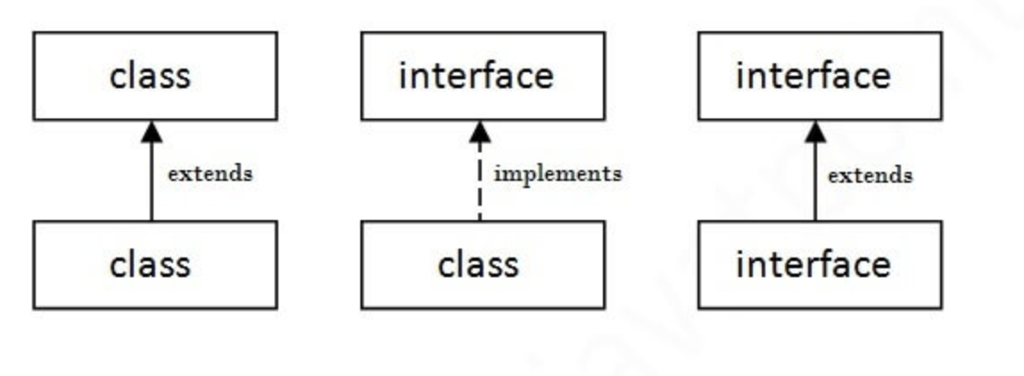
Interface in Java
An interface in Java is a blueprint of a class. It has static constants and abstract methods.
The interface in Java is a mechanism to achieve abstraction. There can be only abstract methods in the Java interface, not method body. It is used to achieve abstraction and multiple inheritance in Java.
It cannot be instantiated just like the abstract class.
Since Java 8, we can have default and static methods in an interface.
Since Java 9, we can have private methods in an interface.
Implements keyword is used
Multiple inheritance

Slide 8
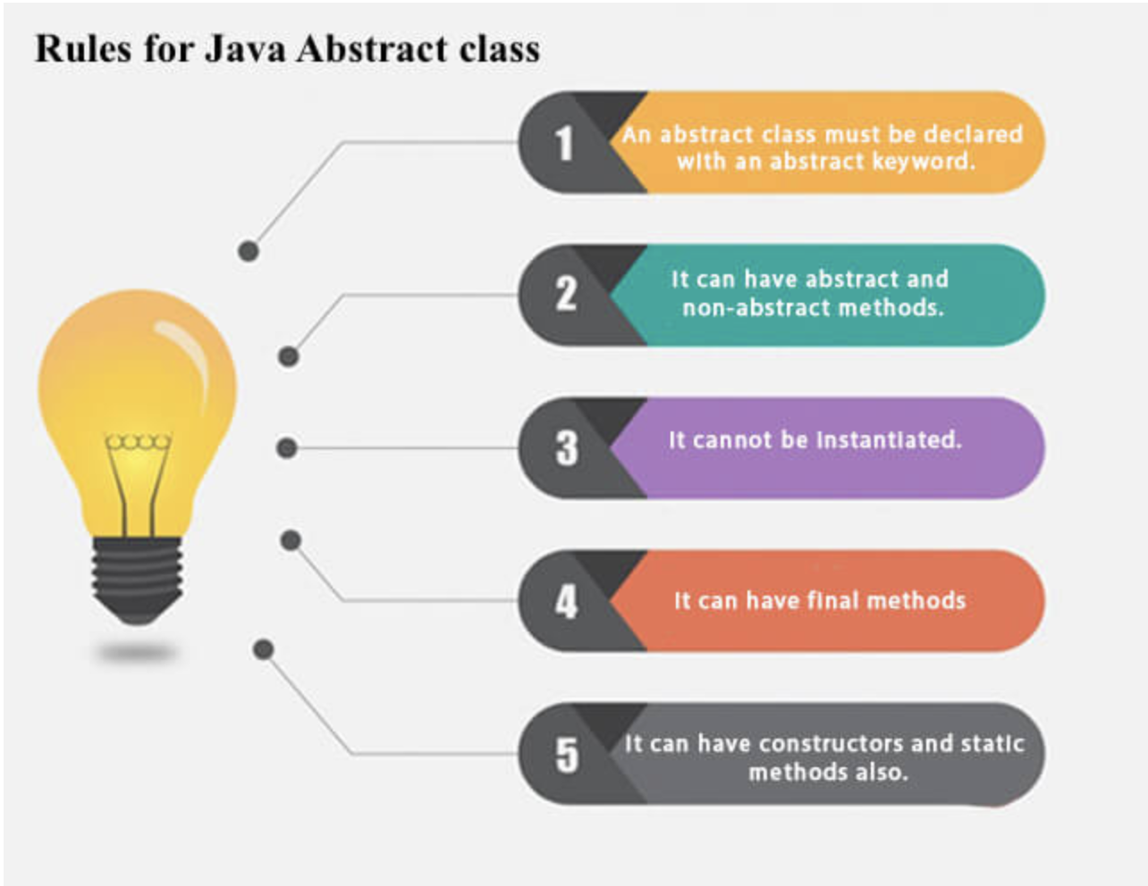
Abstraction in Java
Abstraction is a process of hiding the implementation details and showing only functionality to the user.
There are two ways to achieve abstraction in java
Abstract class (0 to 100%)
Interface (100%)
Abstract class in Java
A class which is declared as abstract is known as an abstract class. It can have abstract and non-abstract methods. It needs to be extended and its method implemented. It cannot be instantiated.
Boolean login(String username,String password);

Slide 9
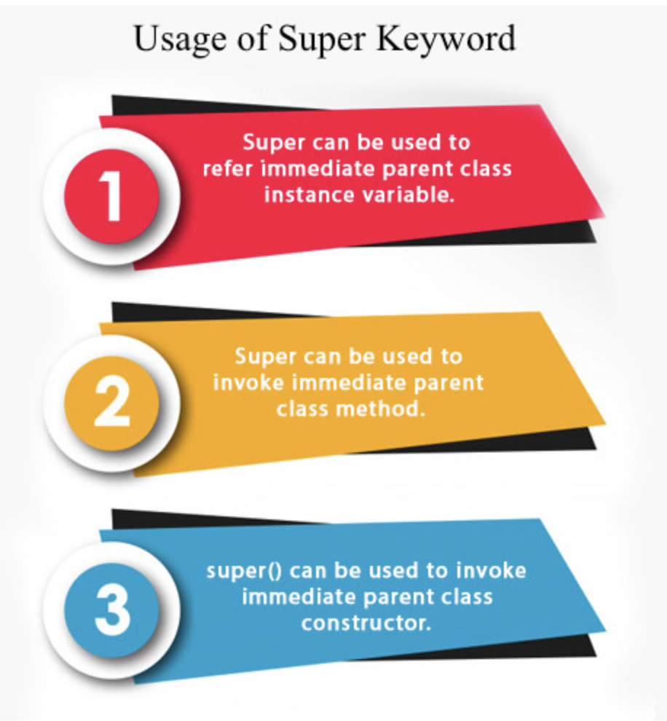
Super Keyword in Java
The super keyword in Java is a reference variable which is used to refer immediate parent class object.
Super should be first line in constructors
Cannot use super in static

Slide 10
this keyword in Java
Usage of java this keyword.
this can be used to refer current class instance variable.
this can be used to invoke current class method (implicitly)
this() can be used to invoke current class constructor.
this can be passed as an argument in the method call.
this can be passed as argument in the constructor call.
this can be used to return the current class instance from the method.

Slide 11
There are two main restrictions for the static method. They are:
The static method can not use non static data member or call non-static method directly.
this and super cannot be used in static context.
We can create static variables at the class level only.
static block and static variables are executed in the order they are present in a program.
When to use static variables and methods?
Use the static variable for the property that is common to all objects. For example, in class Student, all students share the same college name. Use static methods for changing static variables.

Slide 12
LocalDate class is an immutable class that represents Date with a default format of yyyy-mm-dd.
LocalDate date1 = LocalDate.of(2017, 1, 13);
static LocalDate now() It is used to obtain the current date from the system clock in the default time-zone.
boolean isLeapYear() It is used to check if the year is a leap year, according to the ISO proleptic calendar system rules.
LocalDate minusDays(long daysToSubtract) It is used to return a copy of this LocalDate with the specified number of days subtracted.
LocalDate minusMonths(long monthsToSubtract) It is used to return a copy of this LocalDate with the specified number of months subtracted.
LocalDate plusDays(long daysToAdd) It is used to return a copy of this LocalDate with the specified number of days added.
LocalDate plusMonths(long monthsToAdd) It is used to return a copy of this LocalDate with the specified number of months added.
To substract 2 localdates
ChronoUnit.DAYS.between(ld,ld1)

Slide 13
Calendar:
It is an Abstract class, so we cannot use a constructor to create an instance. Instead, we will have to use the static method, Calendar.getInstance() to instantiate and implement a sub-class.
get(int field):
It is used to return the value of the given calendar field.
add(int field, int amount):
It is used to add or subtract the specified amount of time to the given calendar field, based on the calendar’s rules.
set(int calndr_field, int new_val)
It is used to set the calndr_field value to a new_val
Specific calendar:
Calendar calndr = new GregorianCalendar(2018, 9, 2);

Slide 14
Date :
It represents a specific instant in time, with millisecond precision.It provides constructors and methods to deal with date and time with java.
Constructors
Date() : Creates date object representing current date and time.
Date(long milliseconds) : Creates a date object for the given milliseconds since January 1, 1970, 00:00:00 GMT.
Date(int year, int month, int date)
Date(int year, int month, int date, int hrs, int min)
Date(int year, int month, int date, int hrs, int min, int sec)
Date(String s)
Important Methods
boolean after(Date date) : Tests if current date is after the given date.
boolean before(Date date) : Tests if current date is before the given date.
int compareTo(Date date) : Compares current date with given date. Returns 0 if the argument Date is equal to the Date; a value less than 0 if the Date is before the Date argument; and a value greater than 0 if the Date is after the Date argument.
long getTime() : Returns the number of milliseconds since January 1, 1970, 00:00:00 GMT represented by this Date object.
void setTime(long time) : Changes the current date and time to given time.

Slide 15
Multi-Threading vs concurrency vs parallelism

Slide 16
What are Data Structures in Java?
Data Structure in java is defined as the collection of data pieces that offers an effective means of storing and organizing data in a computer.
Types of Data Structures in Java
Array
Stack
Queue
Linked List
Binary Tree
Binary Search Tree

Slide 17
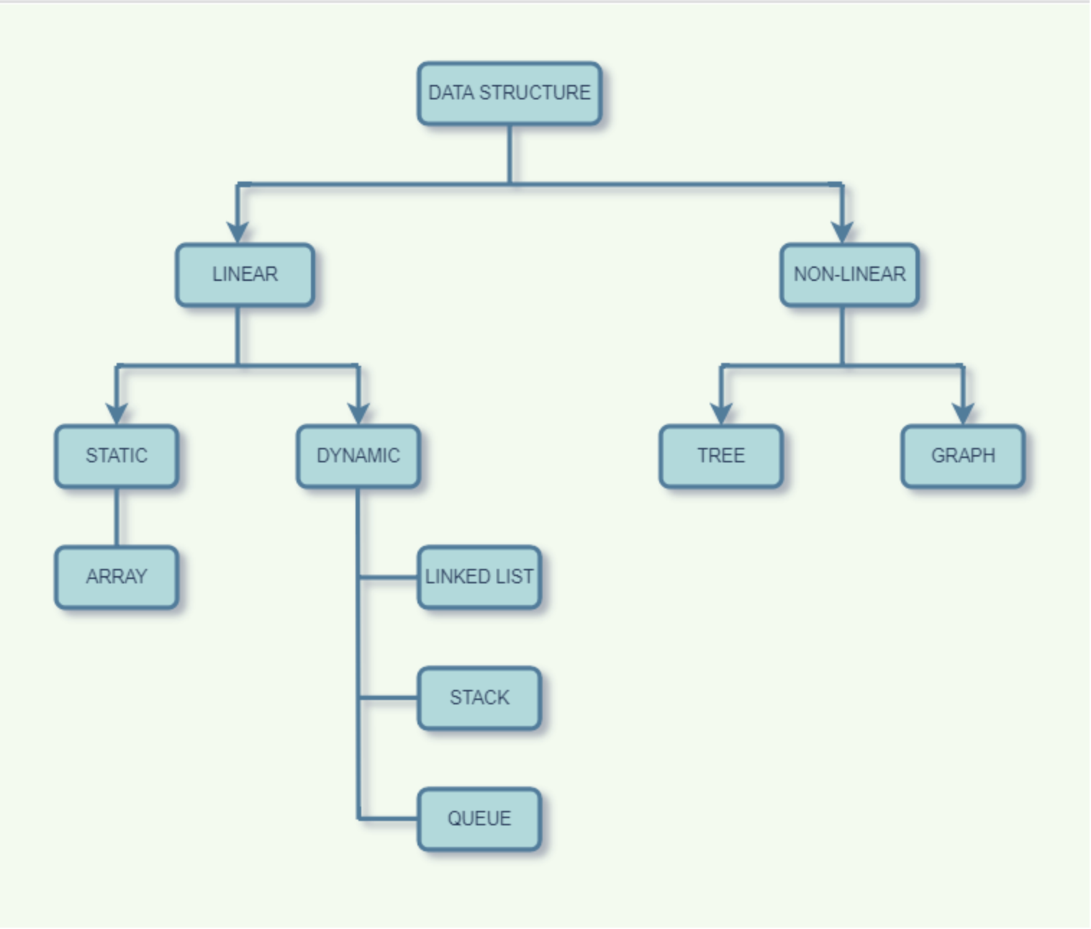

Slide 18
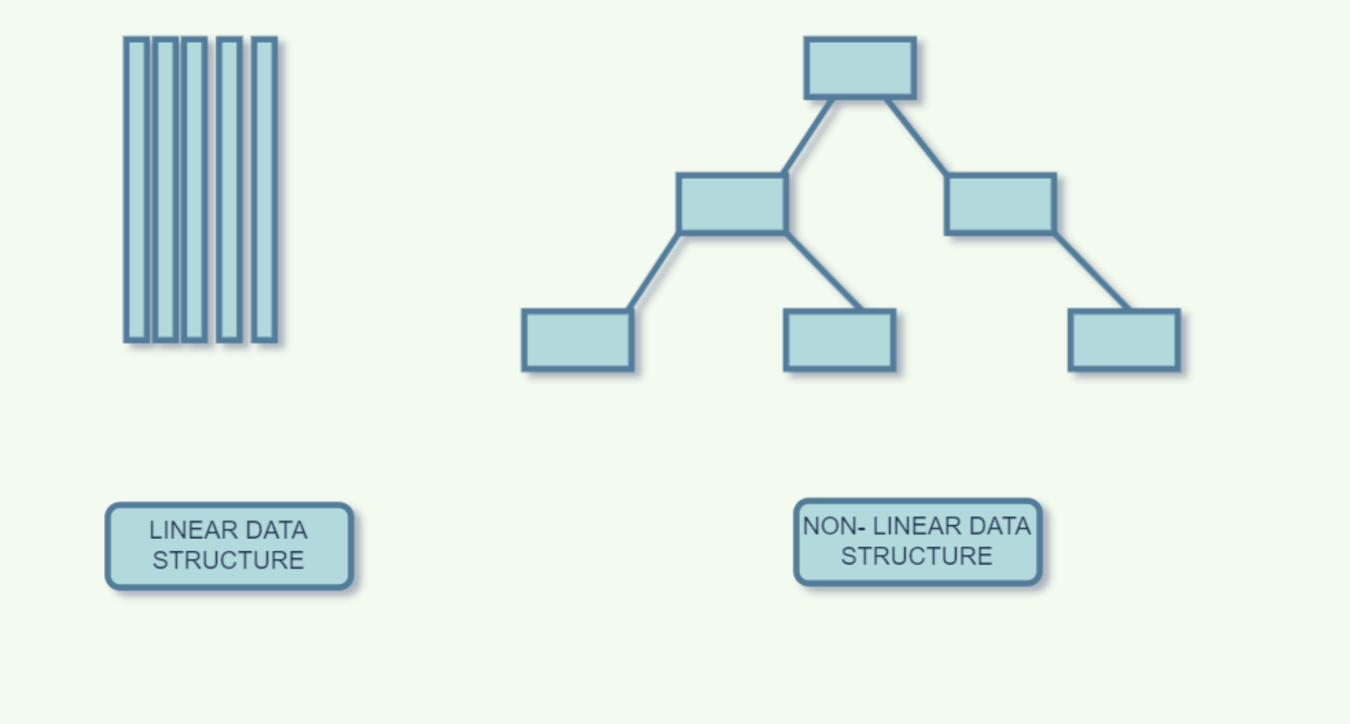

Slide 19
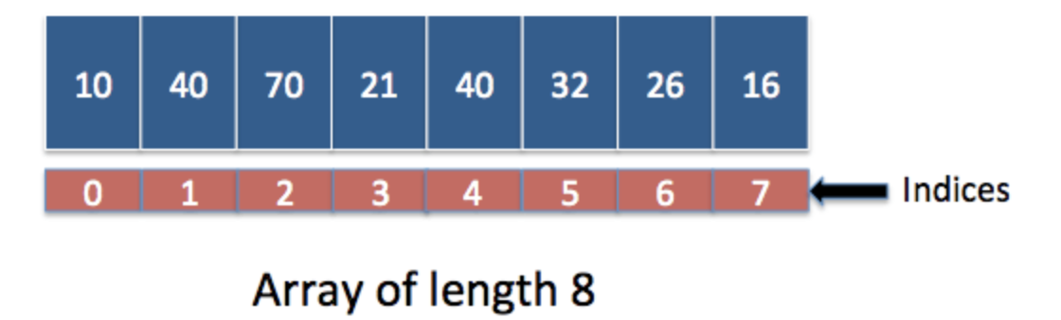
Array
Array is linear data structure which stores fixed number of similar elements. Array can store primitive data types as well as objects, but it should be of same kind. This is one of most used data structures in java.

Slide 20
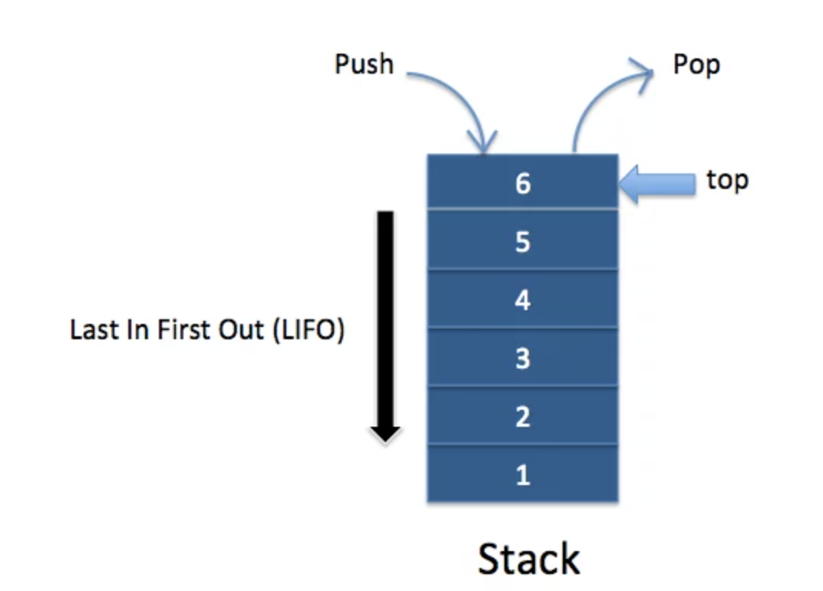
Stack
Stack is abstract data type which depicts Last in first out (LIFO) behavior.

Slide 21
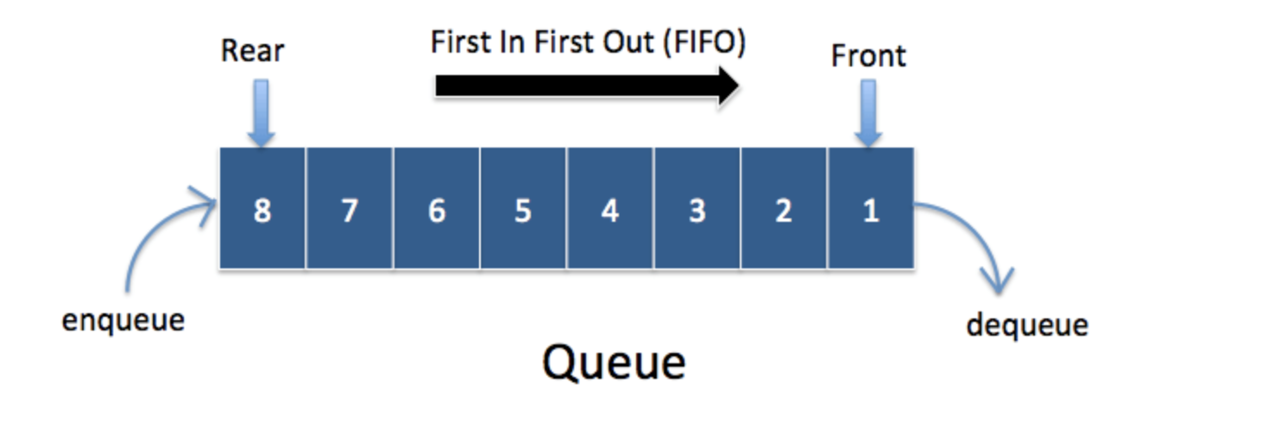
Queue
Queue is abstract data type which depicts First in first out (FIFO) behavior.

Slide 22
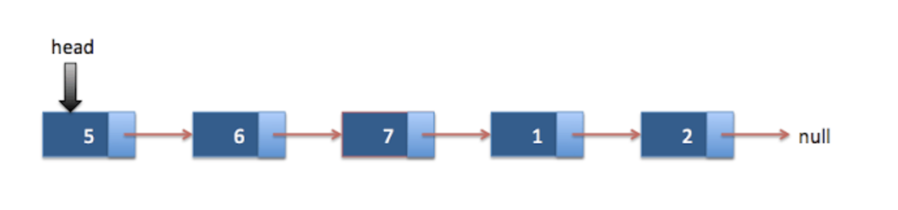
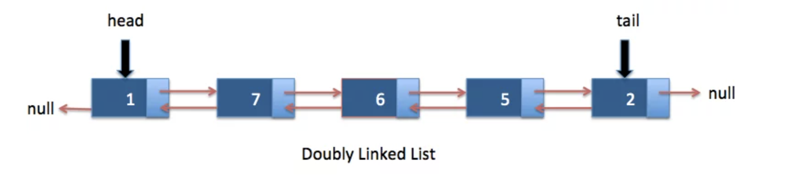
LinkedList
Singly LinkedList
In singly linked list, Node has data and pointer to next node. It does not have pointer to the previous node. Last node ‘s next points to null, so you can iterate over linked list by using this condition.
Doubly LinkedList In doubly linked list, Node has data and pointers to next node and previous node.You can iterate over linkedlist either in forward or backward direction as it has pointers to prev node and next node. This is one of most used data structures in java

Slide 23
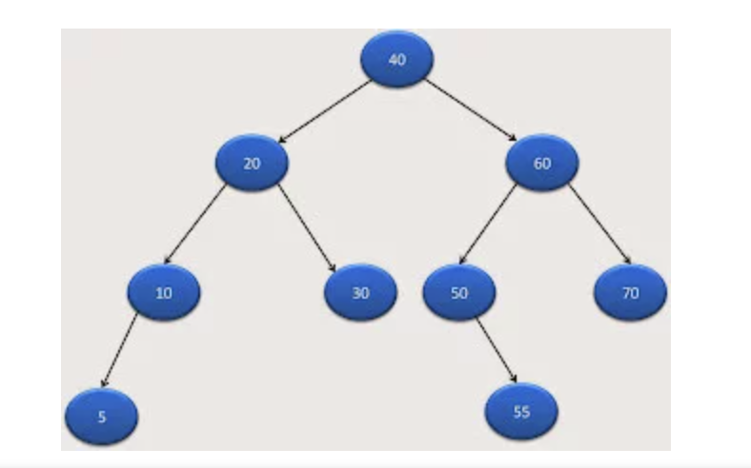
Binary tree
A binary tree is a tree data structure in which each node has at most two children, which are referred to as the left child and the right child

Slide 24
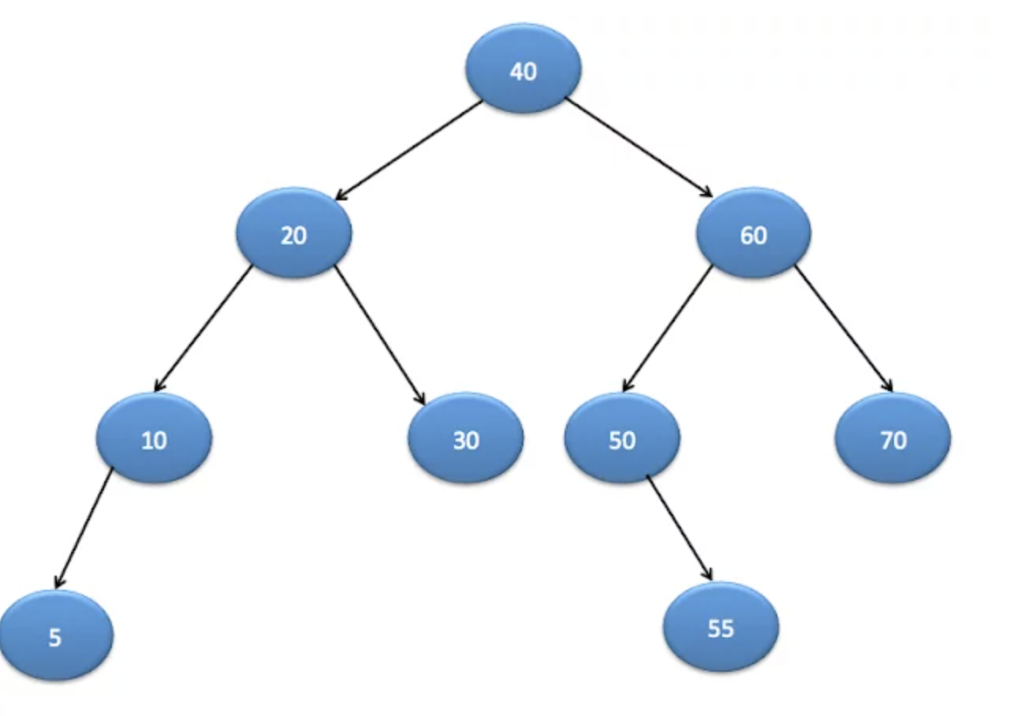
Binary Search tree
Binary search tree is a special type of binary tree which have following properties.
Nodes which are smaller than root will be in left subtree.
Nodes which are greater than root will be right subtree.
It should not have duplicate nodes
Both left and right subtree also should be binary search tree.

Slide 25
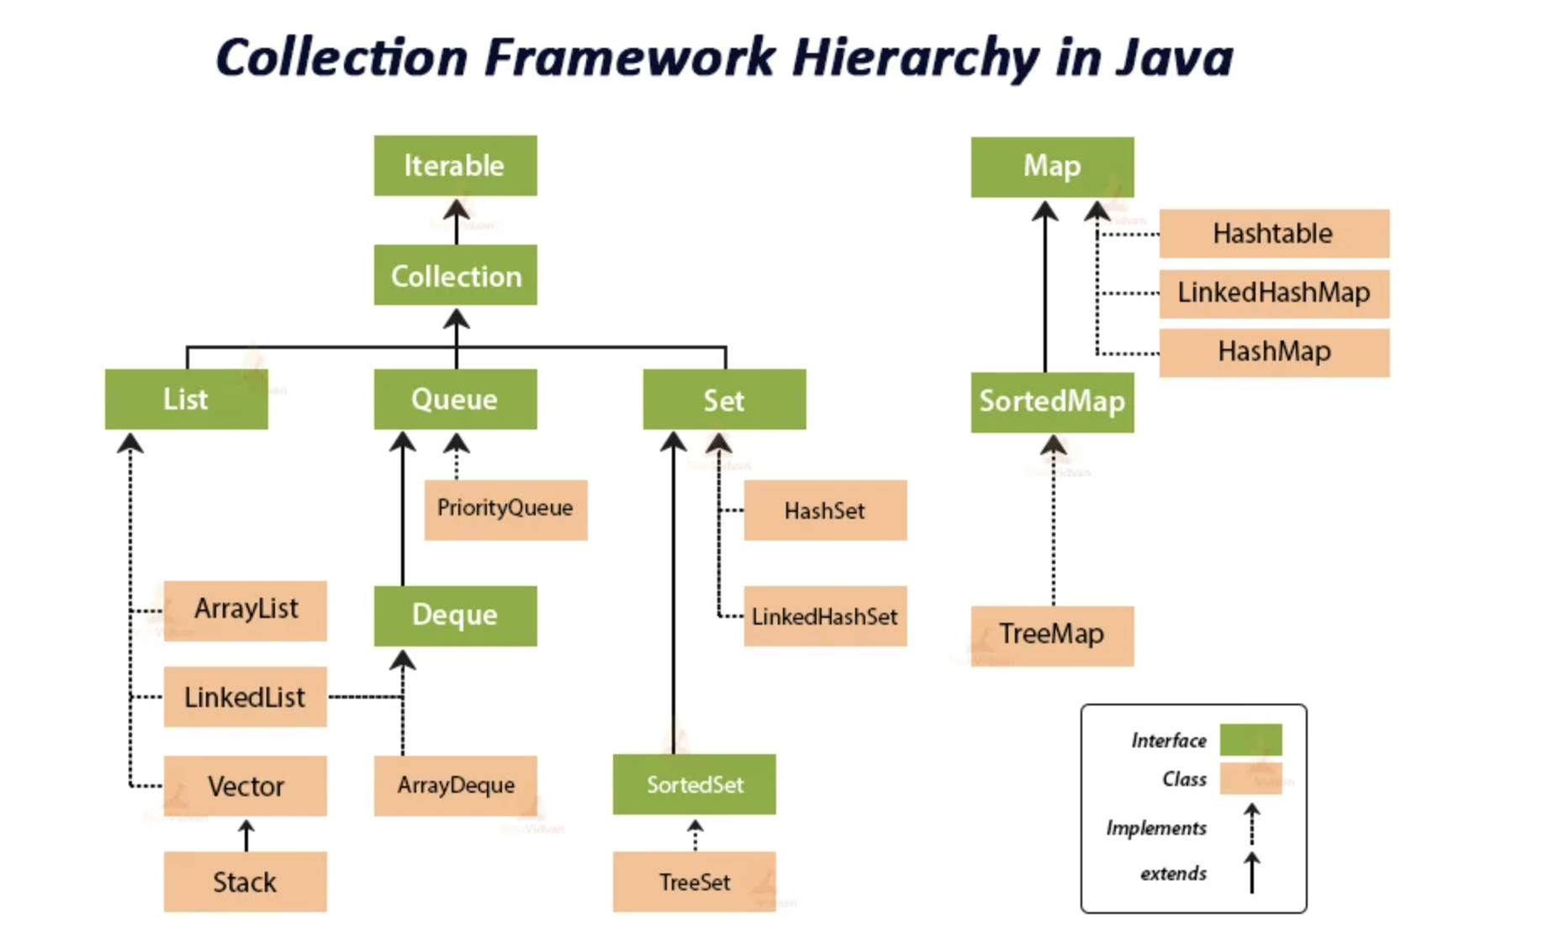

Slide 26
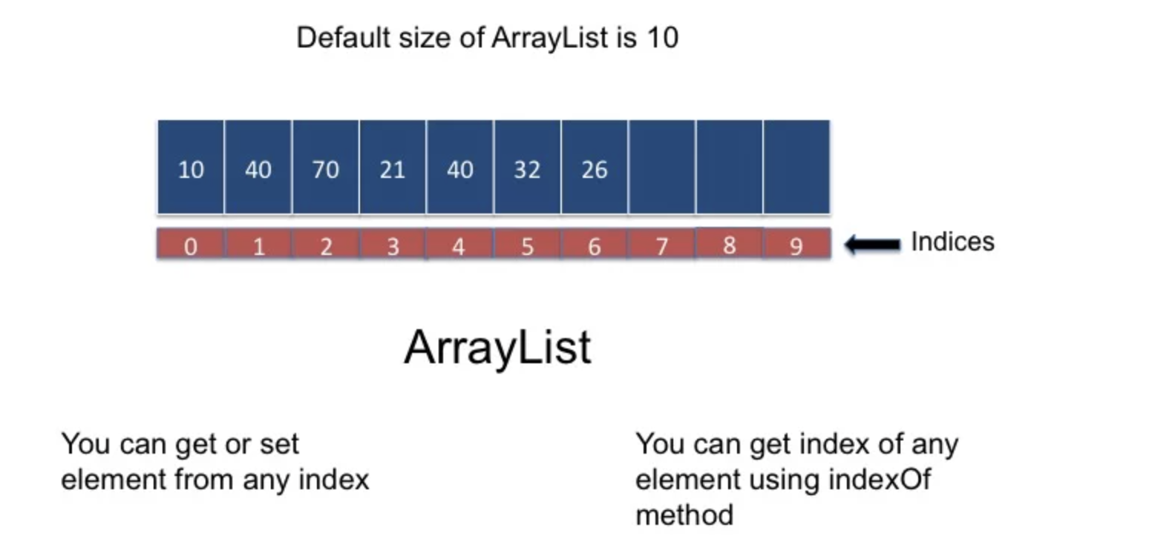
ArrayList
* ArrayList is resizable array which can dynamically grow
* It uses array as internal data structure and increses its size by half when its size is increased
* ArrayList is not synchronized
* ArrayList implements List interface

Slide 27
ArrayList is a part of collection framework and is present in java.util package. It provides us dynamic arrays in Java. Though, it may be slower than standard arrays but can be helpful in programs where lots of manipulation in the array is needed.
ArrayList inherits AbstractList class and implements List interface.
ArrayList is initialized by a size, however the size can increase if collection grows or shrink if objects are removed from the collection.
Java ArrayList allows us to randomly access the list.
ArrayList can not be used for primitive types, like int, char, etc. We need a wrapper class for such cases .
Initialization with add()
Syntax:
ArrayList<String> str = new ArrayList<String>();
str.add("Geeks");
str.add("for");
str.add("Geeks");
Shorthand version:
ArrayList<String> str = new ArrayList<String>(){{
add("Geeks");
add("for");
add("Geeks")
}};

Slide 28
Initialization using asList()
Syntax:
ArrayList<Type> obj = new ArrayList<Type>(
Arrays.asList(Obj A, Obj B, Obj C, ....so on));
Initialization using another Collection
Syntax:
List gfg = new ArrayList(collection);
Initialization using List.of() method
Syntax:
List<Type> obj = new ArrayList<>( List.of(Obj A, Obj B, Obj C, ....so on));

Slide 29
ArrayList Methods:
boolean addAll(Collection c) : This method appends all of the elements in the specified collection to the end of this list, in the order that they are returned by the specified collection’s Iterator.
boolean addAll(Collection c) : This method appends all of the elements in the specified collection to the end of this list, in the order that they are returned by the specified collection’s Iterator.
The clear() method of ArrayList in Java is used to remove all the elements from a list. The list will be empty after this call returns so do whenever this operation has been performed all elements of the corresponding Arraylist will be deleted so it becomes an essential function for deleting elements in ArrayList from memory leading to optimization.
isEmpty()
lastIndexof()
Get()
Set()
Clone()
removeAll()
Size()
parallelStream()
Stream()
forEach()
Length→array
Length() →String/Object
Size()→data structures

Slide 30
Method 1: Using subList() and clear() method
Syntax:
List.subList(int fromIndex, int toIndex).clear()
Method 2: Using removeRange() method
Syntax:
List.removeRange(int fromIndex, int toIndex)

Slide 31
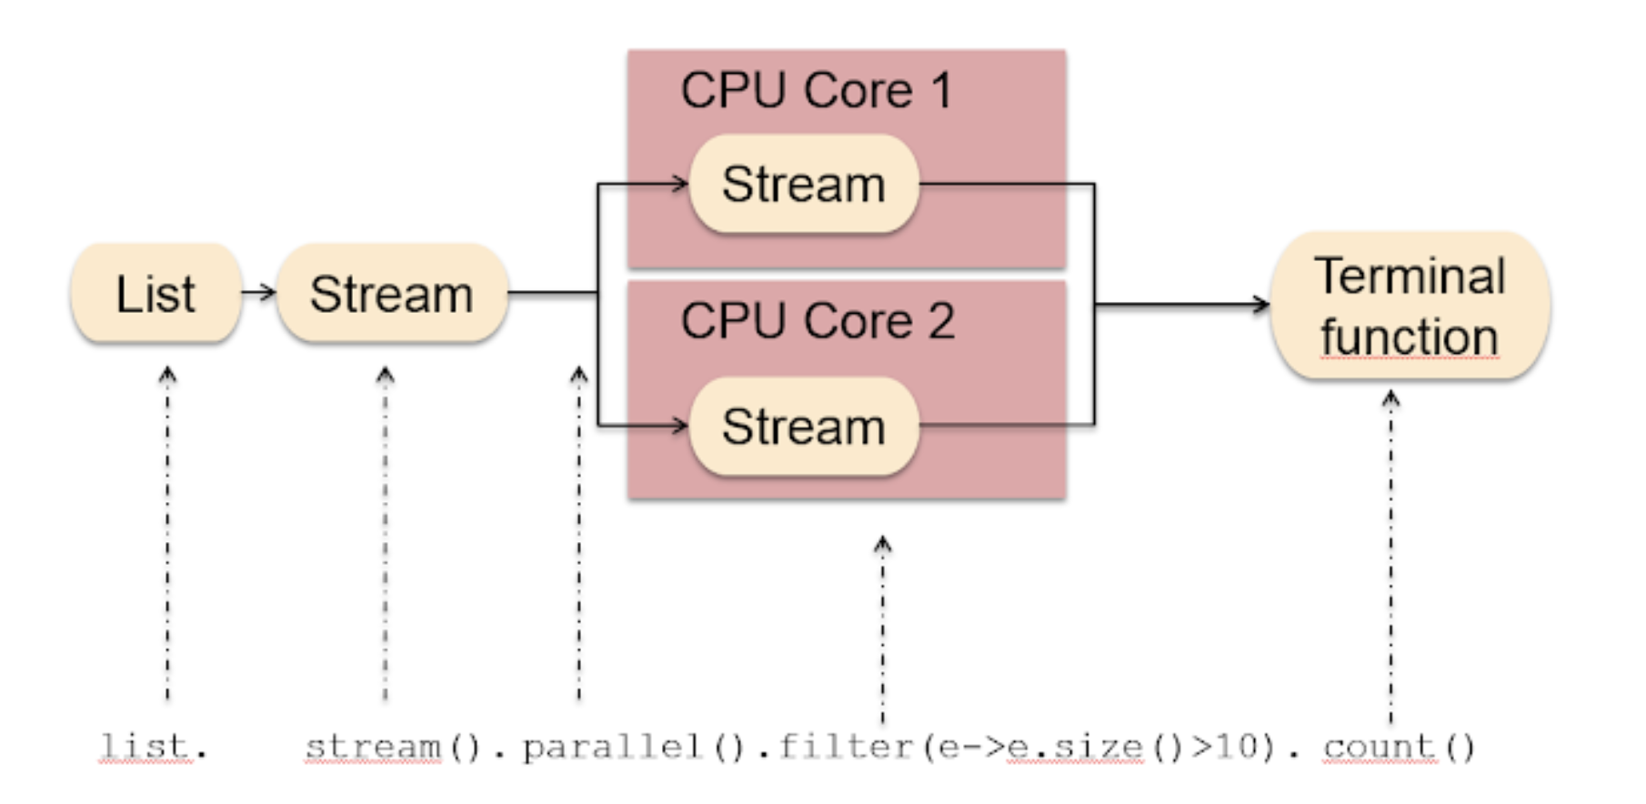
Java Stream APIs
one of the major pieces of new functionality Java 8 had added
stream functionality – java.util.stream – which contains classes for processing sequences of elements.
Multi-threading parallel Stream

Slide 32
Distinct:
distinct() does not take any argument and returns the distinct elements in the stream, eliminating duplicates. It uses the equals() method of the elements to decide whether two elements are equal or not
List<Integer> intList = Arrays.asList(2, 5, 3, 2, 4, 3);
Count:
Count() count number of elements
Filter:
this produces a new stream that contains elements of the original stream that pass a given test (specified by a Predicate).
System.out.println(dist.stream().filter(t-> t>50).count());
Collect:
its one of the common ways to get stuff out of the stream once we are done with all the processing:
System.out.println(dist.stream().filter(t-> t>50).collect(Collectors.toList()));

Slide 33
Map function:
map() produces a new stream after applying a function to each element of the original stream. The new stream could be of different type.
For example:
it can be Integer.parseInt(String number), which takes a string and returns an Integer.
List<String> numbers = Arrays.asList("1", "2", "3", "4", "5", "6", "7", "8", "9");
List<Integer> squares = numbers.stream().map( i -> Integer.parseInt(i)) .collect(Collectors.toList());
flatMap
A stream can hold complex data structures like Stream<List<String>>. In cases like this, flatMap() helps us to flatten the data structure to simplify further operations:
List<List<String>> namesNested = Arrays.asList(
Arrays.asList("Jeff", "Bezos"),
Arrays.asList("Bill", "Gates"),
Arrays.asList("Mark", "Zuckerberg"));
List<String> namesFlatStream = namesNested.stream()
.flatMap(Collection::stream)
.collect(Collectors.toList());

Slide 34
toArray:
We saw how we used collect() to get data out of the stream. If we need to get an array out of the stream, we can simply use toArray():
Student[] students = empList.stream().toArray(Student[]::new);
Skip & limit:
List<Integer> squares1 = squares.stream().skip(2).limit(3).collect(Collectors.toList());
Notes:
https://stackify.com/streams-guide-java-8/

Slide 35
allMatch(Predicate predicate)
returns whether all elements of this stream match the provided predicate.
boolean allMatch(Predicate<? super T> predicate)
Where, T is the type of the input to the predicate and the function returns true if either all elements of the stream match the provided predicate, or the stream is empty, otherwise false.
boolean answer = list.stream().allMatch(n-> n % 3 ==0);
anyMatch(Predicate predicate)
returns whether any elements of this stream match the provided predicate.
boolean anyMatch(Predicate<? super T> predicate)
Where, T is the type of the input to the predicate and the function returns true if any elements of the stream match the provided predicate, otherwise false.
boolean answer = list.stream().anyMatch(n
-> (n * (n + 1)) / 4 == 5);
Notes:
https://stackify.com/streams-guide-java-8/

Slide 36
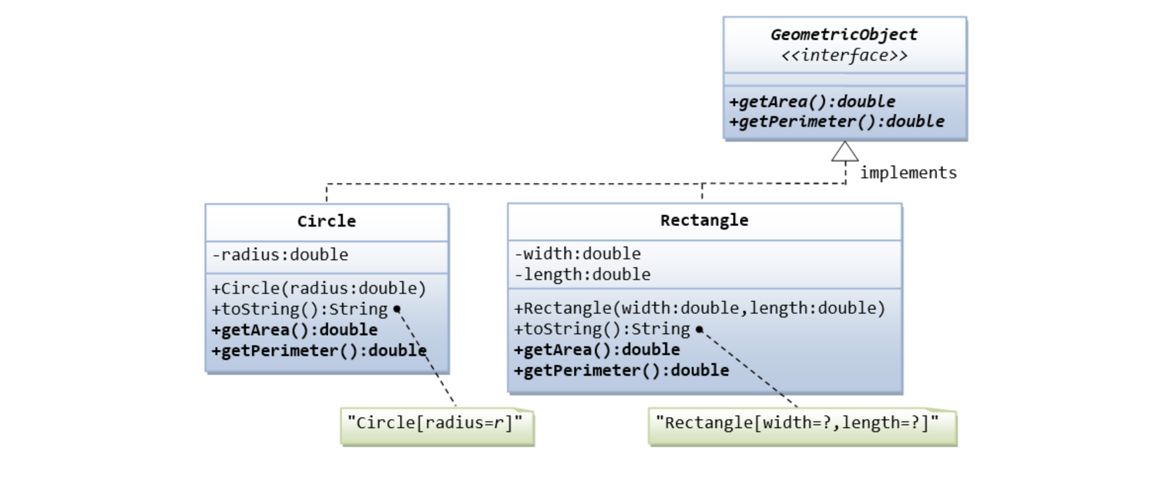
Write an interface called GeometricObject, which contains 2 abstract methods: getArea() and getPerimeter(), as shown in the class diagram. Also write an implementation class called Circle. Mark all the overridden methods with annotation @Override

Slide 37
limitations of Arrays:
1) Size of the array is fixed which is decided when we create an array so it is hard to predict the number of elements in advance, if the declared size fall short then we cannot increase the size of an array and if we declare a large size array and do not need to store that many elements then it is a waste of memory.
2) Array elements need contiguous memory locations to store their values.
3) Inserting an element in an array is performance wise expensive as we have to shift several elements to make a space for the new element. For example:
Let’s say we have an array that has following elements: 10, 12, 15, 20, 4, 5, 100, now if we want to insert a new element 99 after the element that has value 12 then we have to shift all the elements after 12 to their right to make space for new element.

Slide 38
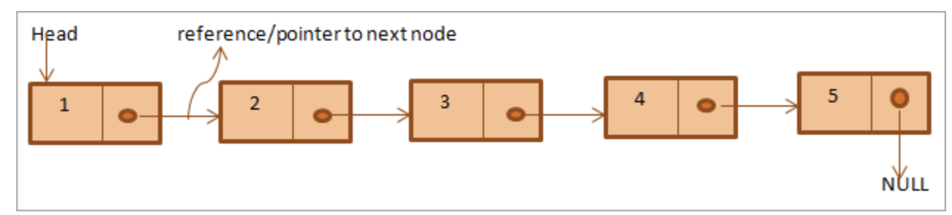
Linked List in Java
A linear data structure used to store the elements in contiguous locations is called a Linked List in Java. It has addresses and pointers that are used to link the elements, and each element in the linked list consists of two parts, namely the data part and the address part. The data part is the value of the element, and the address part consists of the pointers and addresses that are used to link the elements. Each element in the list is called a node.
There Are Various Types of Linked List.
Singular Linked List
Doubly Linked List
Circular Linked List
Singular Linked List

Slide 39
addFirst(Object o):
This method add the specified element at the first position of the list
addLast(Object o):
This method add the specified element at the last position of the list.
getFirst():
This method returns the first element in this linked list.
getLast():
This method returns the last element in this linked list.
removeFirst():
This method retrieves and removes the head element from this linked list.
removeLast():
This method retrieves and removes the last element from this linked list.

Slide 40
Peek():
Retrieves and but does not remove the head (first element) of this list
peekFirst():
Retrieves and but does not remove the head (first element) of this list
peekLast():
Retrieves and but does not remove the tail (last element) of this list
Poll():
Retrieves and removes the head (first element) of this list.
pollFirst():
Retrieves and removes the head (first element) of this list
pollLast():
Retrieves and removes the Tail (last element) of this list
pop():
Pops an element from the stack represented by this list. In other words, removes and returns the first element of this list.
This method is equivalent to removeFirst().

Slide 41
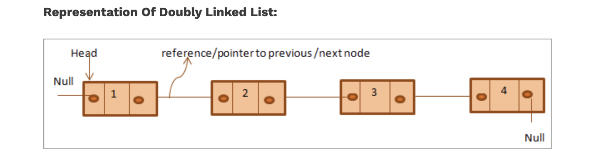
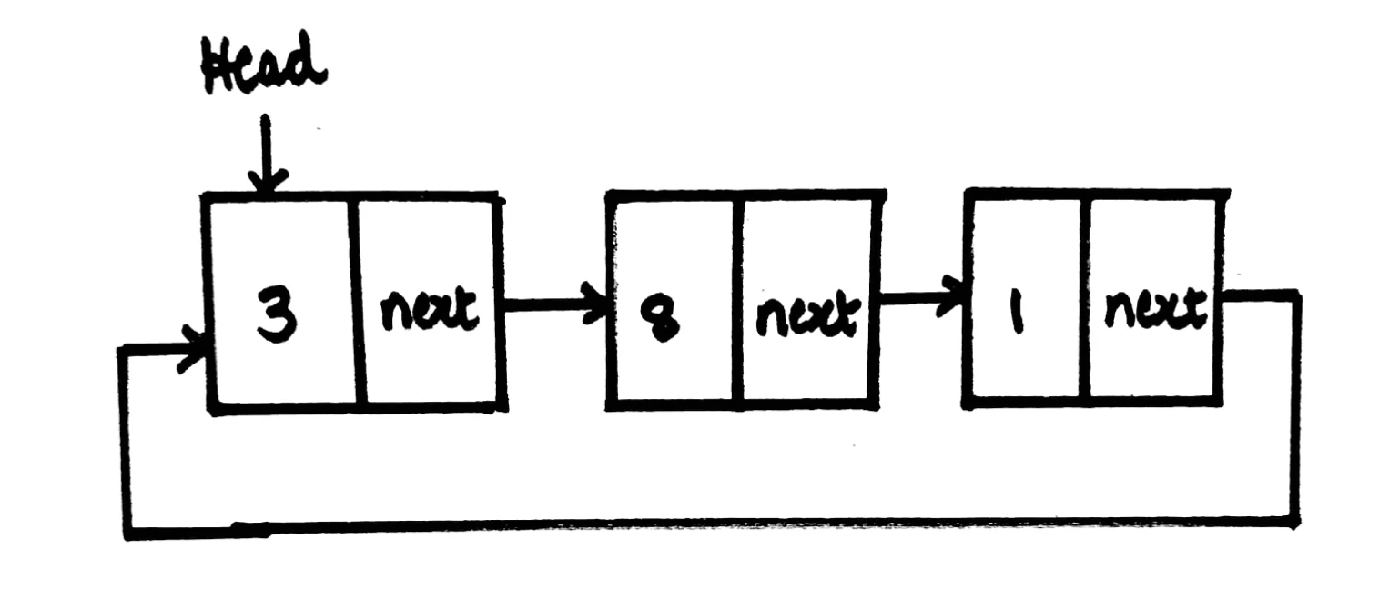
Doubly Linked List
Circular Linked List

Slide 42
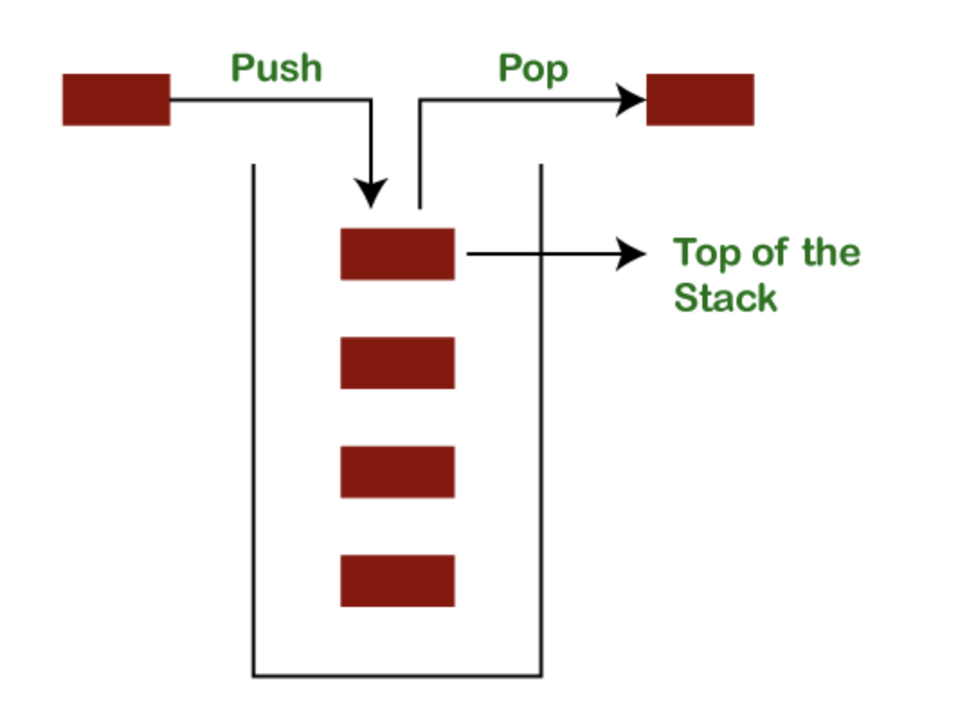
Java Vector
Vector is like the dynamic array which can grow or shrink its size. Unlike array, we can store n-number of elements in it as there is no size limit. It is found in the java.util package and implements the List interface, so we can use all the methods of List interface here.
Vector is Synchronized.
Java Stack
The stack is a linear data structure that is used to store the collection of objects. It is based on Last-In-First-Out (LIFO).

Slide 43
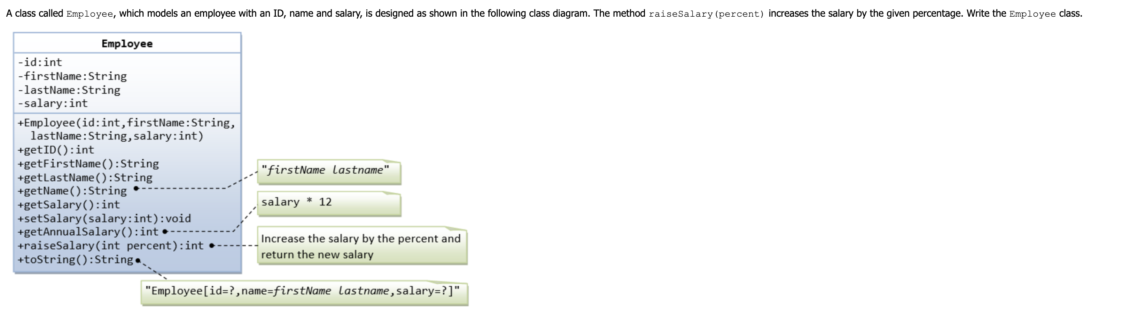

Slide 44
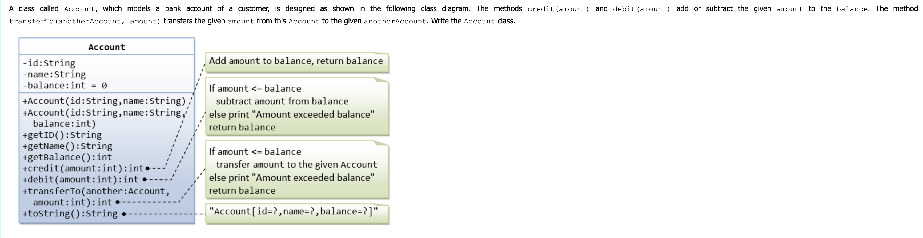

Slide 45
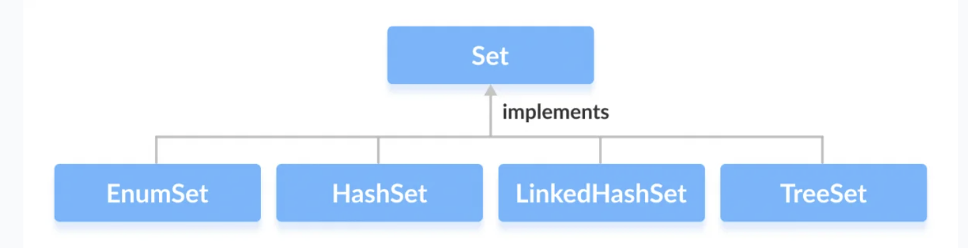
Set in Java
The set is an interface available in the java.util package. The set interface extends the Collection interface. An unordered collection or list in which duplicates are not allowed is referred to as a collection interface

Slide 46
Set is a type of collection that does not allow duplicate elements. That means an element can only exist once in a Set.
Characteristics of a Set collection:
Duplicate elements are not allowed.
Elements are not stored in order. That means you cannot expect elements sorted in any order when iterating over elements of a Set.
Set can contain a null element
HashSet: is the best-performing implementation and is a widely-used Set implementation. It represents the core characteristics of sets: no duplication and unordered.
LinkedHashSet: This implementation orders its elements based on insertion order. So consider using a LinkedHashSet when you want to store unique elements in order.
TreeSet: This implementation orders its elements based on their values, either by their natural ordering, or by a Comparator provided at creation time.
Therefore, besides the uniqueness of elements that a Set guarantees, consider using HashSet when ordering does not matter; using LinkedHashSet when you want to order elements by their insertion order; using TreeSet when you want to order elements by their values.

Slide 47
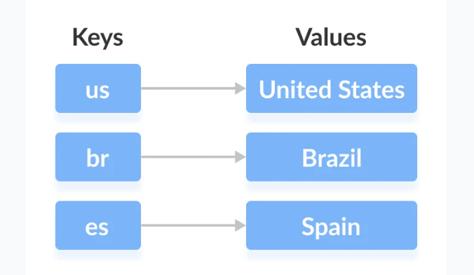
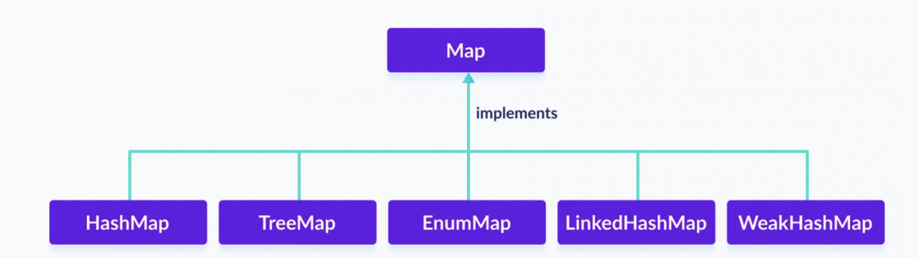
In Java, elements of Map are stored in key/value pairs. Keys are unique values associated with individual Values. A map cannot contain duplicate keys. And each key is associated with a single value.

Slide 48
HashMap<K, V> numbers = new HashMap<>();
Methods of Map:
put(K, V) - Inserts the association of a key K and a value V into the map. If the key is already present, the new value replaces the old value.
putAll() - Inserts all the entries from the specified map to this map.
putIfAbsent(K, V) - Inserts the association if the key K is not already associated with the value V.
get(K) - Returns the value associated with the specified key K. If the key is not found, it returns null.
getOrDefault(K, defaultValue) - Returns the value associated with the specified key K. If the key is not found, it returns the defaultValue.
containsKey(K) - Checks if the specified key K is present in the map or not.
containsValue(V) - Checks if the specified value V is present in the map or not.
replace(K, V) - Replace the value of the key K with the new specified value V.

Slide 49
replace(K, oldValue, newValue) - Replaces the value of the key K with the new value newValue only if the key K is associated with the value oldValue.
remove(K) - Removes the entry from the map represented by the key K.
remove(K, V) - Removes the entry from the map that has key K associated with value V.
keySet() - Returns a set of all the keys present in a map.
values() - Returns a set of all the values present in a map.
entrySet() - Returns a set of all the key/value mapping present in a map.
Entry {k
v}
TreeMap:
TreeMap<Key, Value> numbers = new TreeMap<>();
the elements in TreeMap are sorted naturally (ascending order).

Slide 50
SortedMap:
Elements are auto sorted in ascending order
SortedMap<Key, Value> numbers = new TreeMap<>();
firstKey() - returns the first key of the sorted map
lastKey() - returns the last key of the sorted map
headMap(key) - returns all the entries of a map whose keys are less than the specified key
tailMap(key) - returns all the entries of a map whose keys are greater than or equal to the specified key
subMap(key1, key2) - returns all the entries of a map whose keys lies in between key1 and key2 including key1

Slide 51
Java is pass by Value

Slide 52
The Exception Handling in Java is to handle the runtime errors so that the normal flow of the application can be maintained.
Types of Java Exceptions
There are mainly two types of exceptions: checked and unchecked. An error is considered as the unchecked exception. However, according to Oracle, there are three types of exceptions namely:
Checked Exception
Unchecked Exception
Error
try | The "try" keyword is used to specify a block where we should place an exception code. It means we can't use try block alone. The try block must be followed by either catch or finally.
catch | The "catch" block is used to handle the exception. It must be preceded by try block which means we can't use catch block alone. It can be followed by finally block later.
finally | The "finally" block is used to execute the necessary code of the program. It is executed whether an exception is handled or not.
throw | The "throw" keyword is used to throw an exception.
throws | The "throws" keyword is used to declare exceptions. It specifies that there may occur an exception in the method. It doesn't throw an exception. It is always used with method signature.

Slide 53
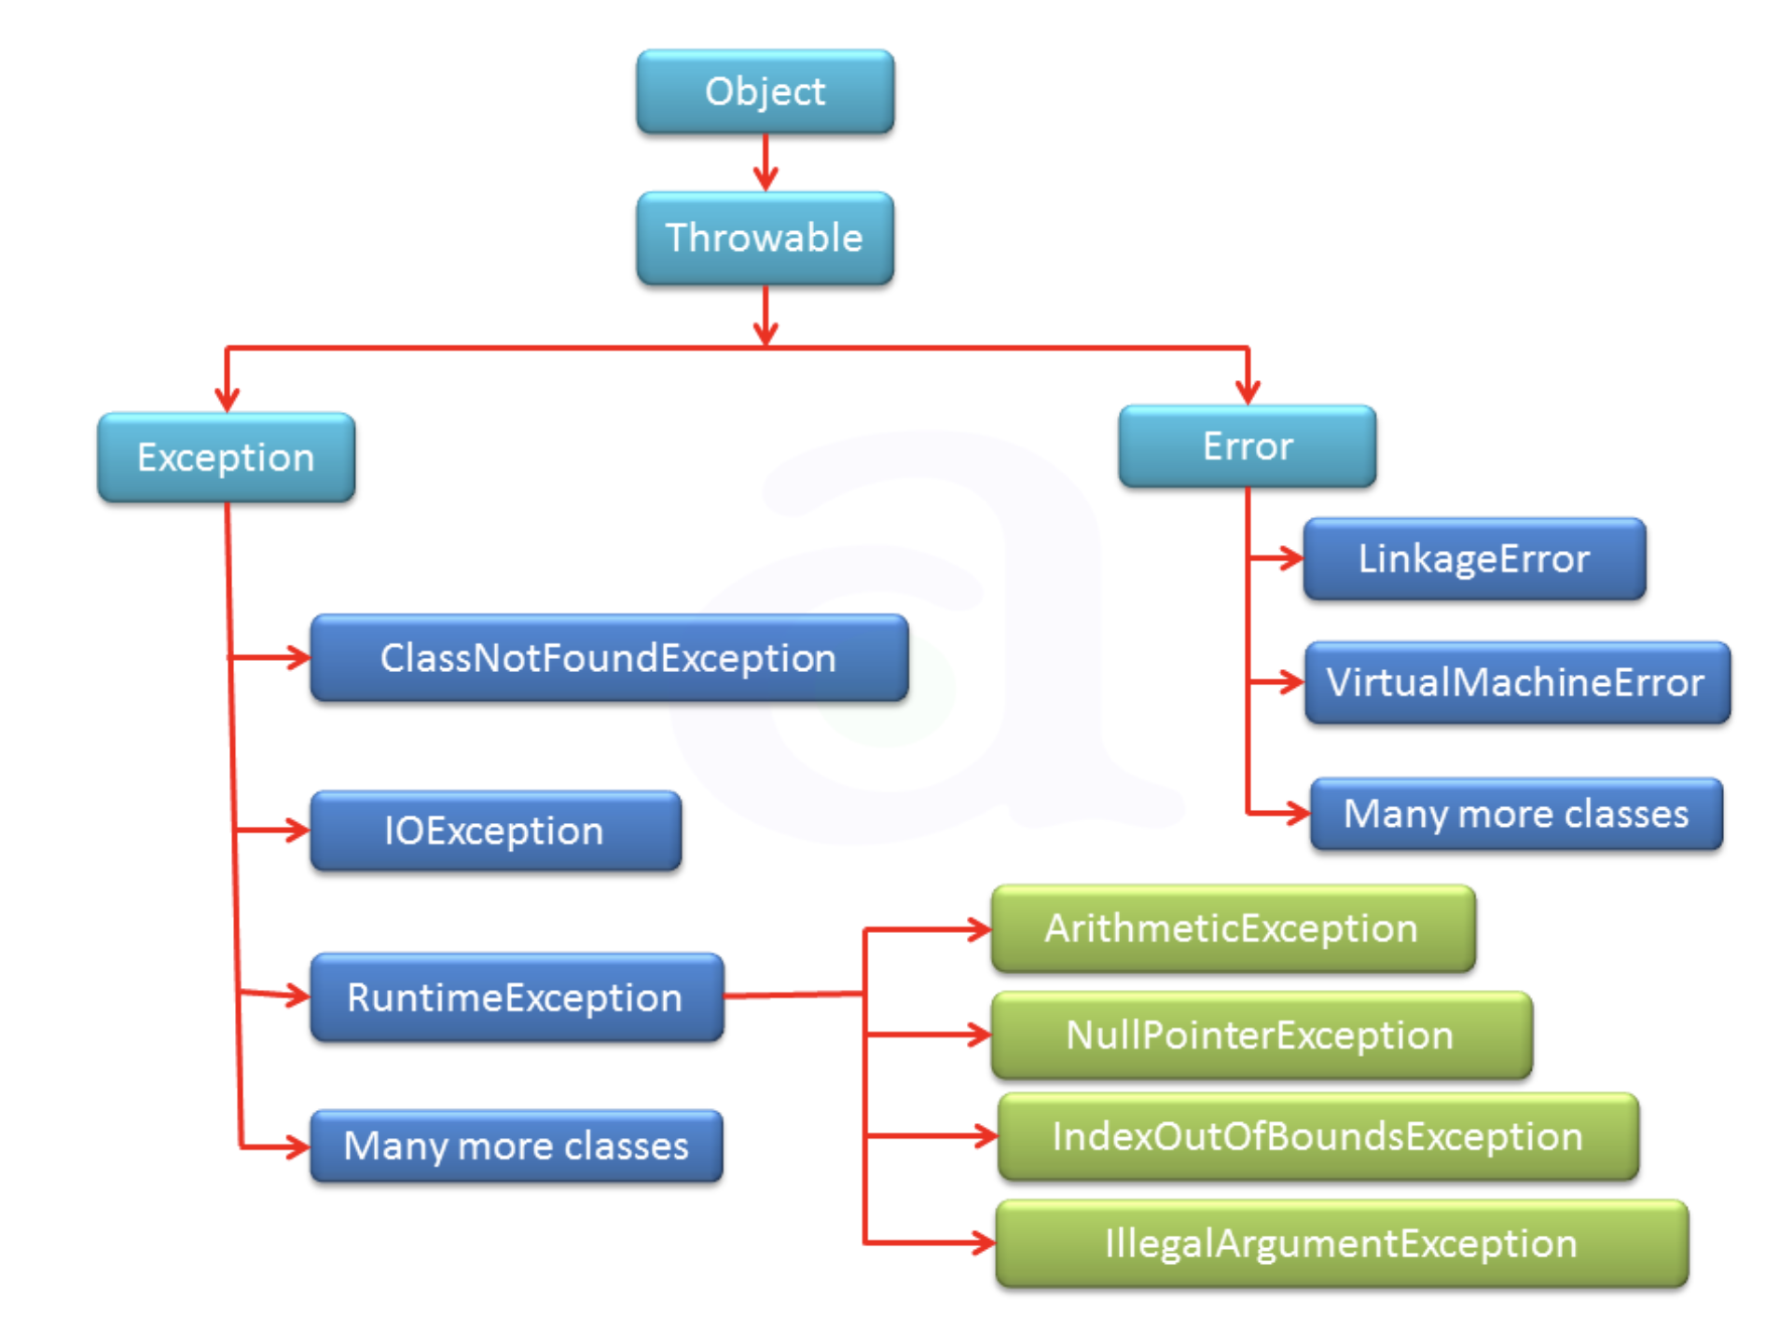

Slide 54
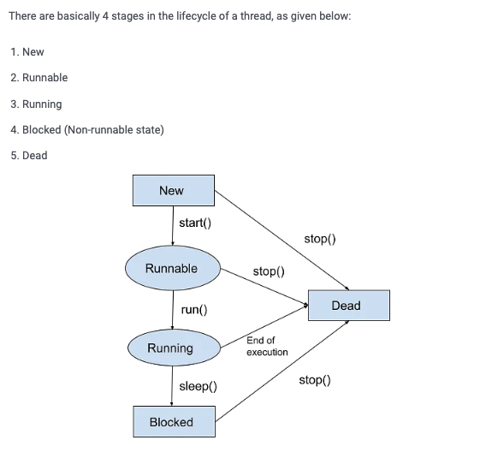
Threads
A thread in Java is the direction or path that is taken while a program is being executed. Generally, all the programs have at least one thread, known as the main thread, that is provided by the JVM or Java Virtual Machine at the starting of the program’s execution. At this point, when the main thread is provided, the main() method is invoked by the main thread.
A thread is an execution thread in a program. Multiple threads of execution can be run concurrently by an application running on the Java Virtual Machine.
The priority of each thread varies. Higher priority threads are executed before lower priority threads.
Create Threads: Extending java.lang.Thread class Implementing Runnable interface
Lifecycle of a Thread in Java
Java Thread Priorities
The number of services assigned to a given thread is referred to as its priority.
Any thread generated in the JVM is given a priority. The priority scale runs from 1 to 10.
1 is known as the lowest priority.
5 is known as standard priority.
10 represents the highest level of priority.
The main thread's priority is set to 5 by default, and each child thread will have the same priority as
its parent thread. We have the ability to adjust the priority of any thread, whether it is the main thread or
a user-defined thread. It is advised to adjust the priority using the Thread class's constants,
which are as follows:
Thread.MIN_PRIORITY
Thread.NORM_PRIORITY
Thread.MAX_PRIORITY

Slide 55
Thread Constructors Thread()
Thread(String)
Thread (Runnable r)
Thread (Runnable r, String r)
Multithreading in Java
In Java, multithreading is the method of running two or more threads at the same time to maximize CPU utilization. As a result, it is often referred to as Concurrency in Java
How to Handle Thread Deadlock
A deadlock is a situation in which two or more threads are stuck waiting for each other indefinitely. When several threads need the same locks but receive them in separate orders, a deadlock occurs. In a Java multithreaded program, a deadlock condition may occur because the synchronized keyword causes the executing thread to block while waiting for the lock, associated with the specified object

